Slide 1

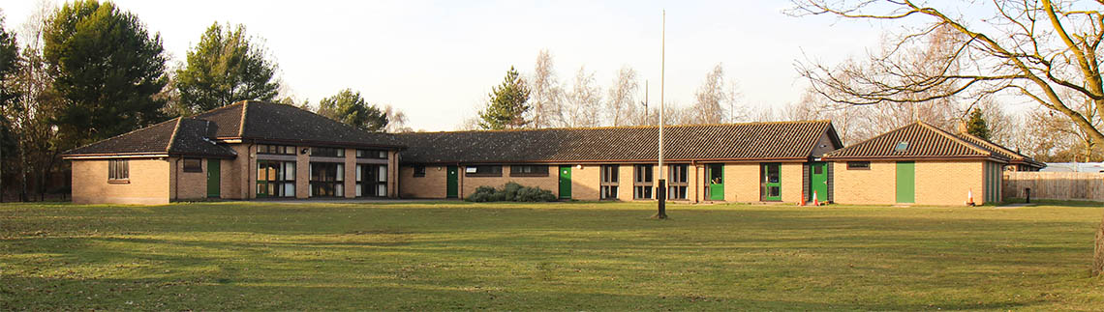
Escape to Hallowtree
Carl Reeder
Notes:
Email sent to Parent in advance…
One of the thing we are doing this week is doing an Escape Room challenge within the Zoom meeting.
If you have time can you provide your children with:
A sheet of A4 paper
Pen
Sleeping Bag
Tin of Heinz Baked beans
The First Harry Potter Book
Building blocks of some kind – Jenga bricks, Dice, DVDs – something to build a quick tower with
Tape Measure
(if you have two children in Scouts I suggest you have two of everything – so they can compete individually – Except maybe the Harry Potter book)
If you don’t have the Harry Potter Book or Heinz beans as it’s a team event hopefully they can rely on the other Scouts having the items to hand.
During the meeting they will be asked to chase around for other household items to add to the excitement. By all means feel free to join in or watch from a far, it should be entertaining.

Slide 2
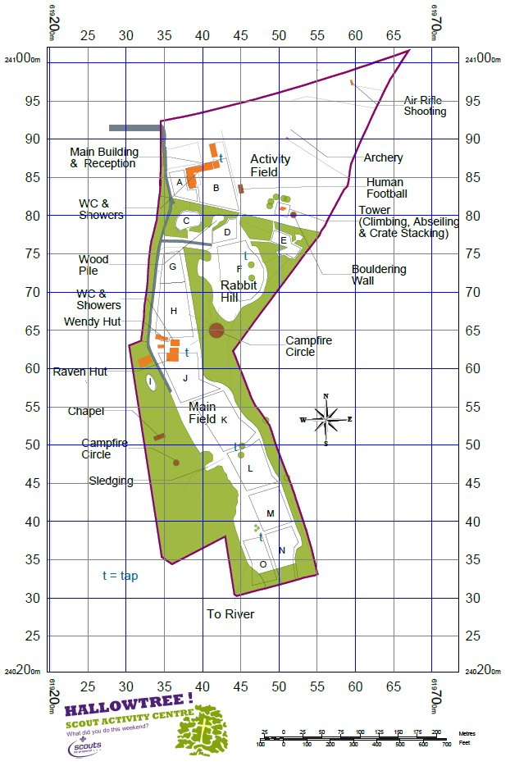
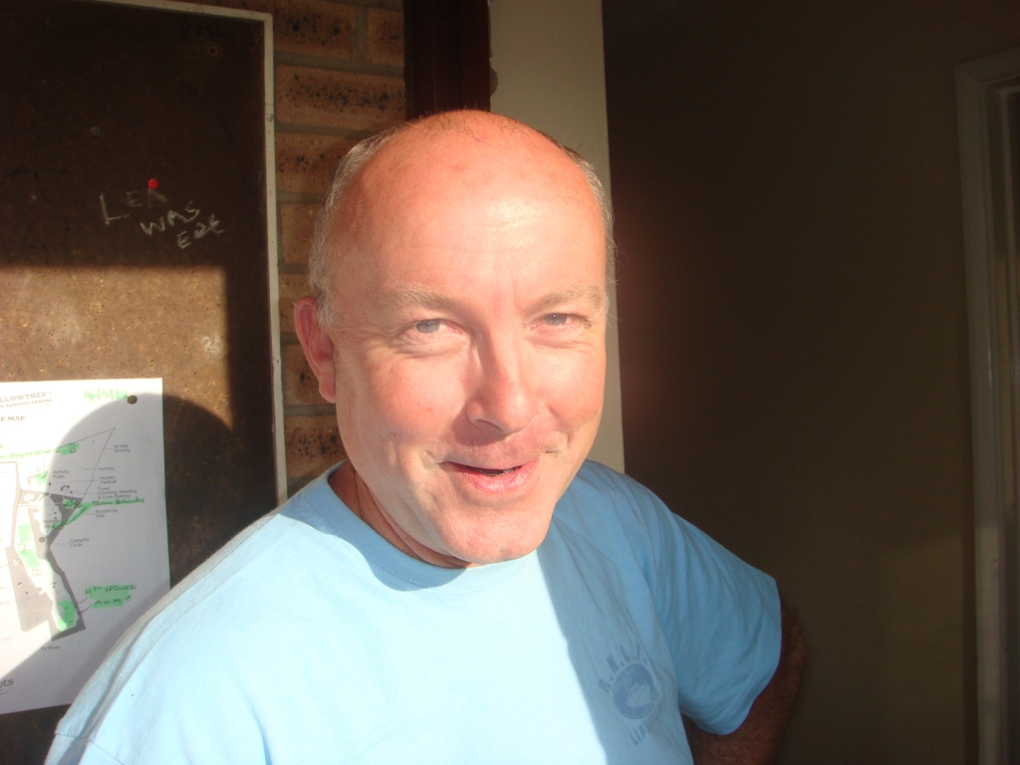
Booking in at Hallowtree
Hi, my name is John.
I am the Warden here at Hallowtree.
You are here on the map!
To find your designated campsite you will need to work out this puzzle…
Find a Harry Potter book, the Philosopher’s Stone – Turn to Chapter 9 – ‘The Midnight Duel’
First Letter of Chapter is you campsite.
Enjoy your camp…
You are here
Notes:
H for Harry is the first letter of the chapter. Only move on, once audience gives you the correct answer.
2

Slide 3
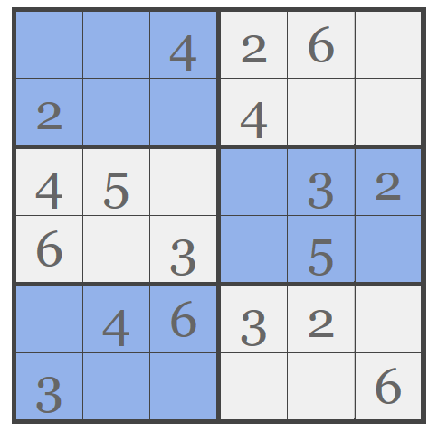
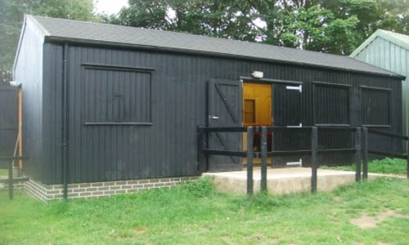
Wendy Hut
Well done – you are on Campsite H – You have access to the Wendy Hut. The Combination lock to the Wendy Hut is hidden in this Sudoko Puzzle. Copy the puzzle down and solve it and you can get in and unload your provisions. You will need the three numbers in the red boxes.
1
3
5
6
5
1
3
1
6
You have broken the code!
2
1
4
5
1
1
2
5
4
Notes:
Wait for the Answer 135 before hitting continue…Once the door is open click the next slide.
3

Slide 4
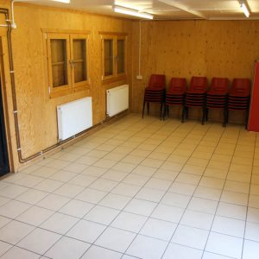
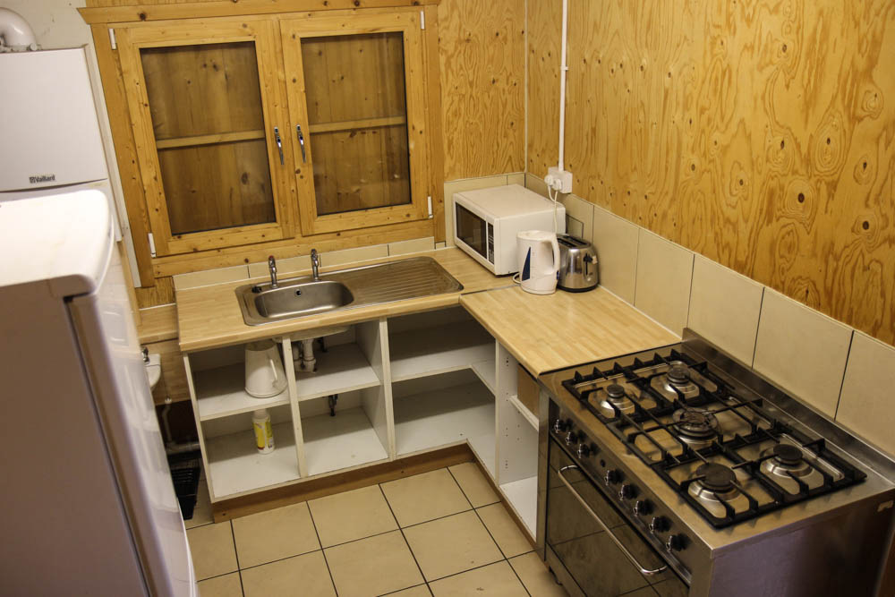
The Wendy Hut
The Wendy Hut is a 7m x 4m wooden cabin situated near to the toilet/shower block, near the campfire circle and close to parking areas.
It is a useful shelter for campsite H. It has a kitchen with electric oven, gas hob, microwave and fridge freezer.
The cabin comes equipped with 30 chairs and 6 tables. It is also wheelchair accessible.

Slide 5
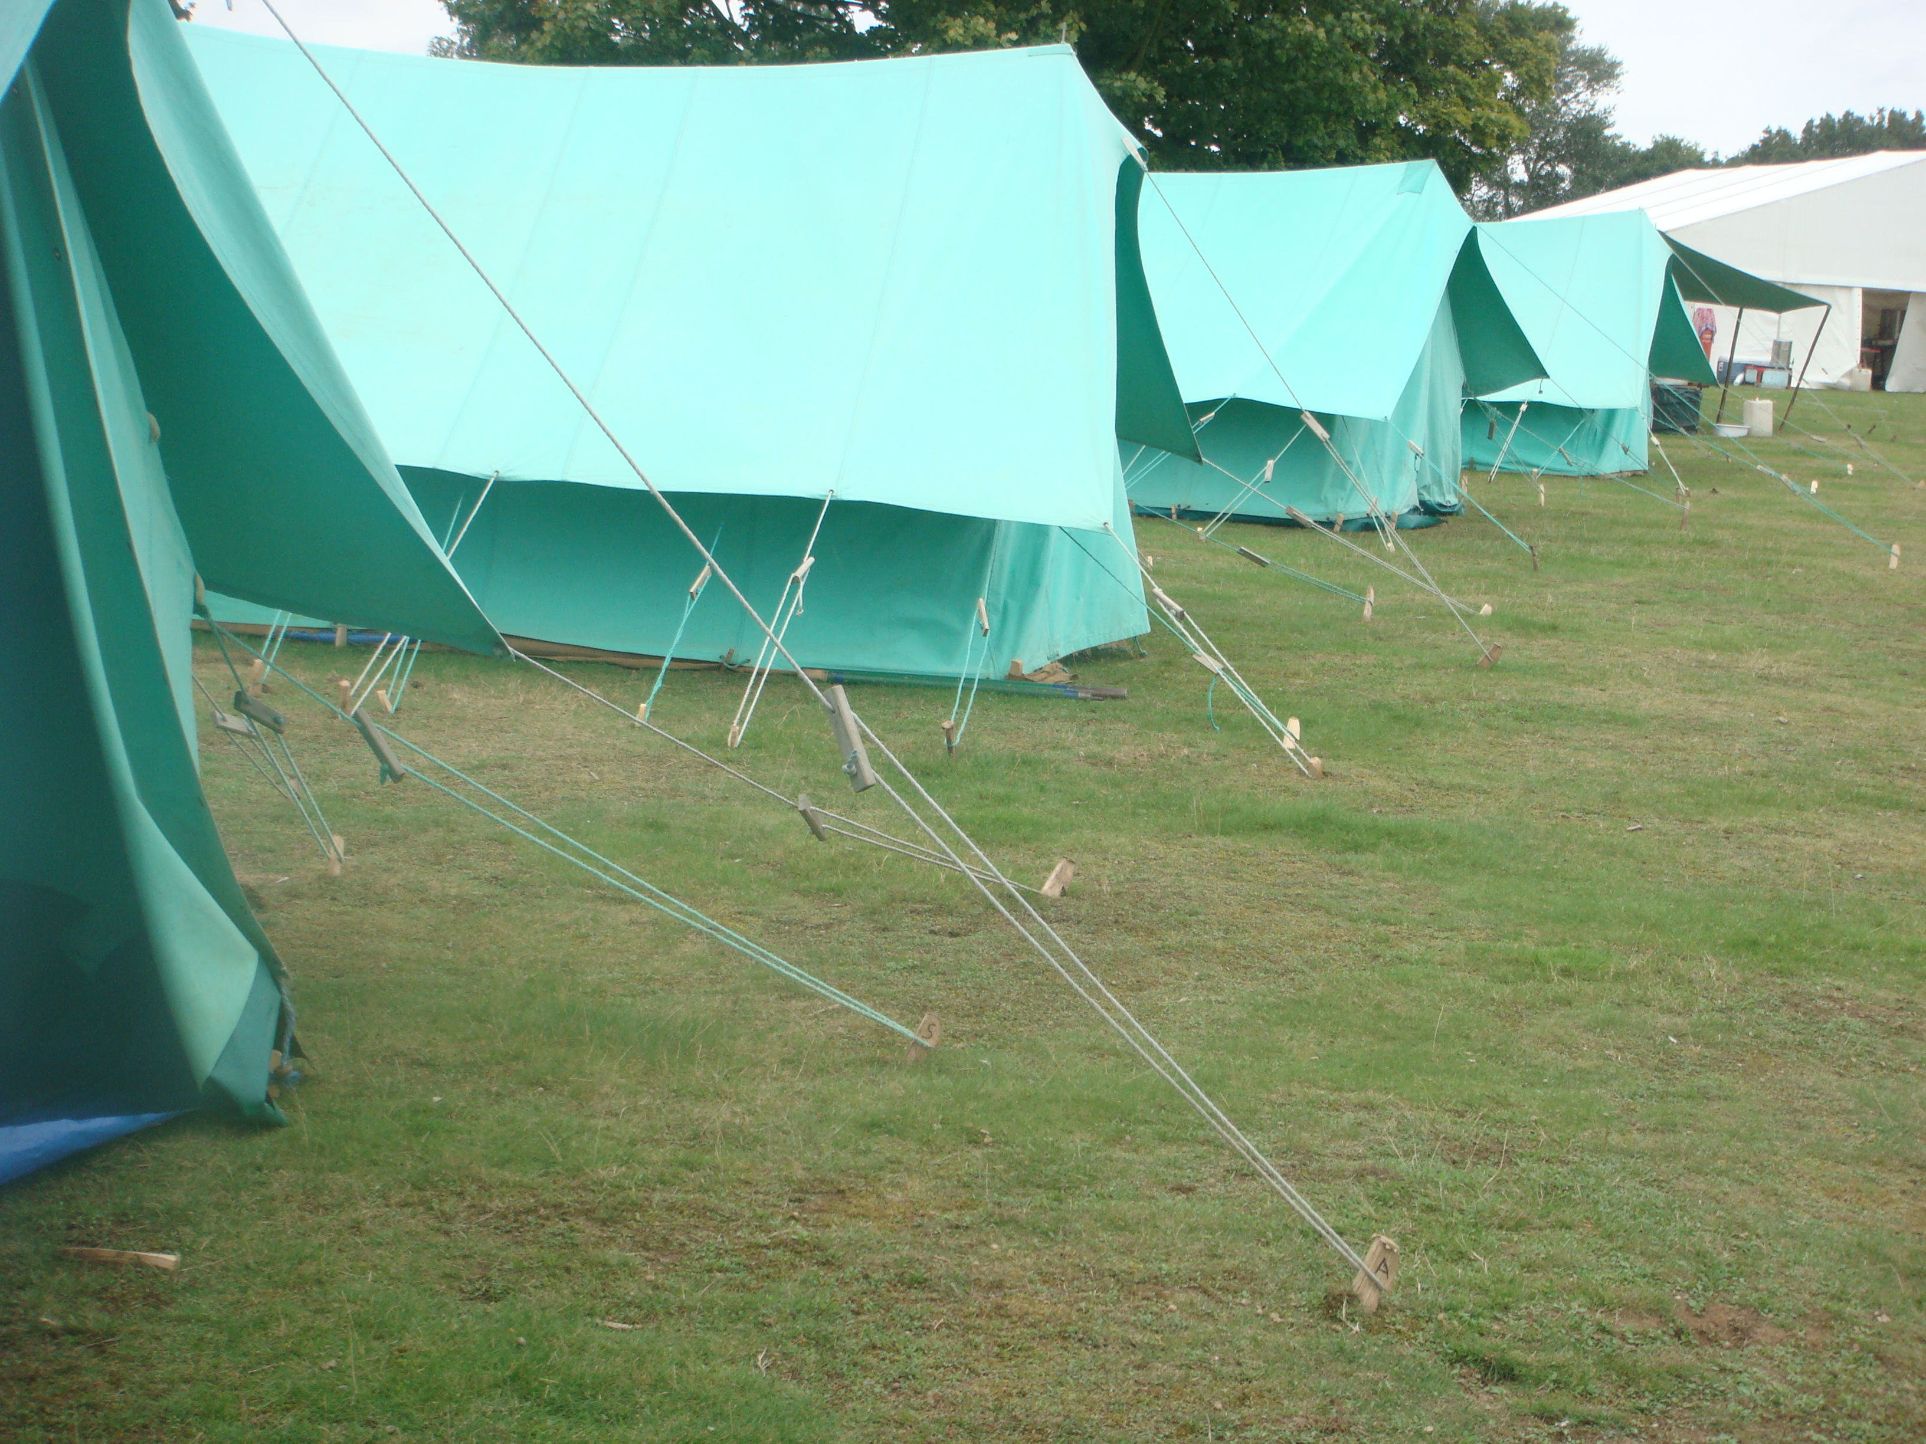
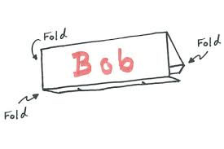
Put your tents up.
Now its time to put your tents up.
Find a Sheet a of A4 Paper and make a Tent Card out of it. Write your name on it.
Once everyone has a completed Tent Card we can play a wide game!

Slide 6
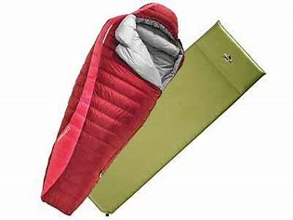
Now its time to get your stuff into the tent and play an online wide game.
First person to get their sleeping bag. Go!
Everyone get in their sleeping bag.
Oh No! you forgot your torch – get out of your sleeping bag and find your torch. Race to get back into sleeping bag with said item.
Everyone back in their sleeping bag….
Oh no….I forgot my….
Notes:
Need to make it clear to Scouts that they have to have their sleeping bag on properly and their head has to be covered and zip done up.
Race to get out of sleeping bag as quickly as possible and retrieve items needed for camp….
Torch
Toothbrush
Sweets
Pillow
Oh now I need the toilet – Piece of toilet paper. Keep going for a s long as you like.
Press the next slide to start the next day.
6

Slide 7

One at a time – who can make the loudest snoring noise?
Morning Scouts time to get up
Notes:
Ask them all to make the loudest snoring noise.

Slide 8

Flag Break
Get ready for flag – How quick can you get your scarf on and stand to attention.
Now say the Scout Promise together.
To get to the next activity you need to find the number of the following letters in the Scout Promise.
How many P’s are there?
How many B’s are there?
How many A’s are there?
On my honour,
I promise that I will do my best
to do my duty to God
and to the Queen,
to help other people
and to keep the Scout Law.
5
1
4
Notes:
P = 5
B = 1
A = 4
You can either make it easier or harder b revealing the Scout Promise on the screen.
8

Slide 9

Breakfast
To cook and eat your breakfast you need to find out how many Kilo Joules (kJ) there are in a Heinz baked bean tin.
Ok now tidy up and put the Tin of beans back were you found them. Go!
Notes:
There are 682kJ per ½ Can of Heinz baked beans. So 682 x 2 = 1364kJ – once they get the right answer – move onto the next slide.
If they don’t have Heinz at home then you will need to rely on other Scouts.
9

Slide 10
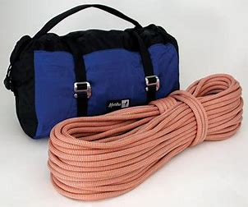
We are going Crate Stacking – Part 1
Go and ask John for Ropes, Helmets and Harnesses.
John: The Activity Store is behind
the main hall.
To get in you will need the following code.
3+4*5 for the first two digits,
3³ for the third and fourth digit. (3 cubed)
Don’t forget BODMAS
Answer:
Door to Activity store
2
3
2
7
Now take the gear to the climbing tower!
Notes:
4*5 = 20 + 3 = 23
3 x 3 x 3= 27
Door code is: 2327
10

Slide 11
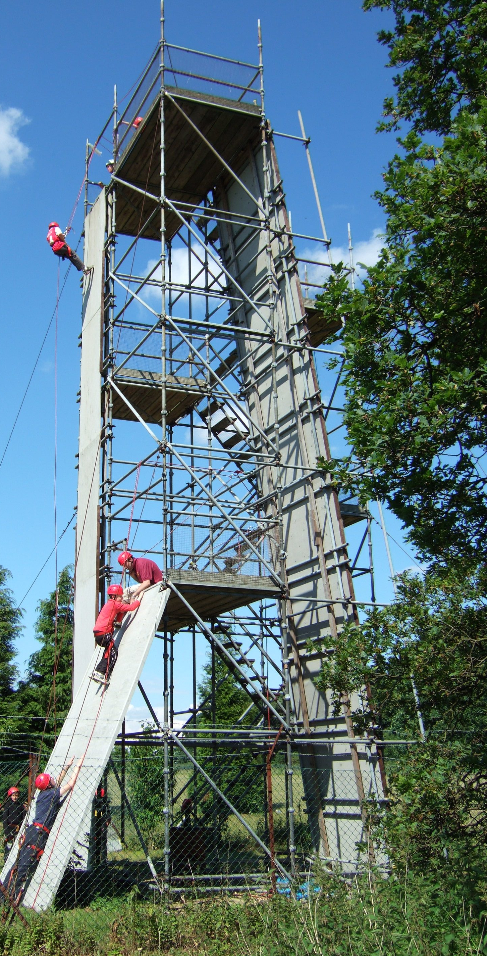


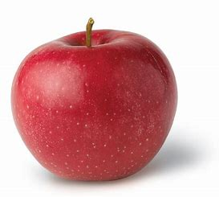
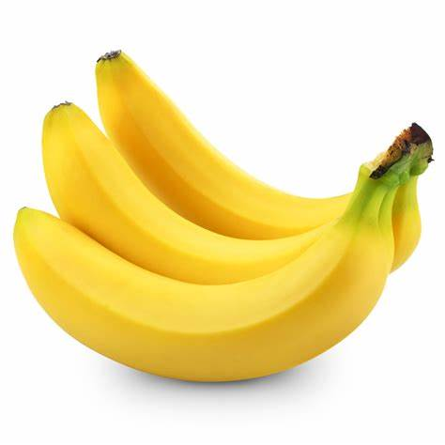
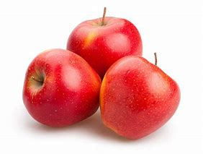
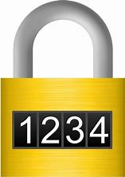
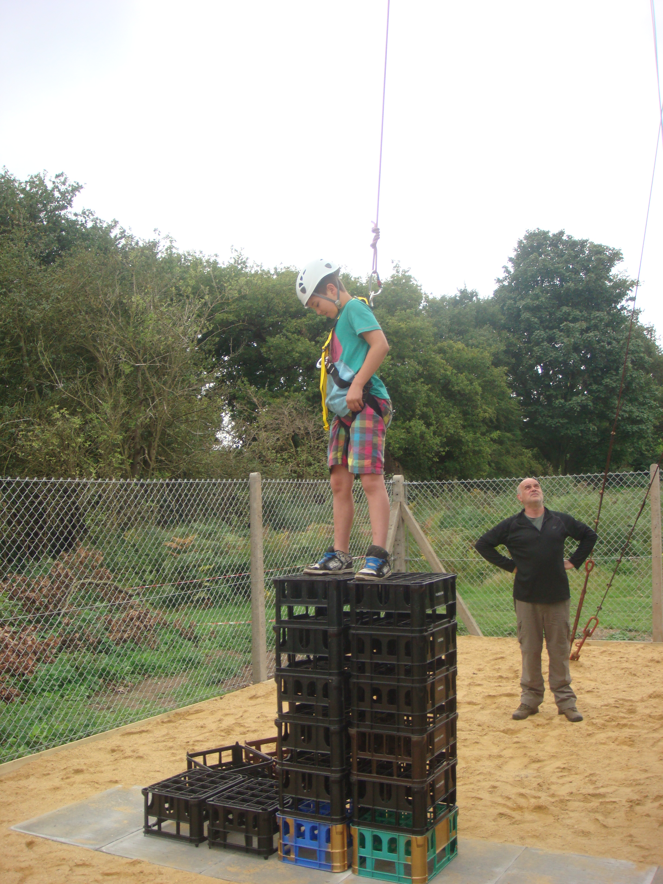
Crate Stacking – Part 2
Get key code to gain access to climbing tower.
+
+
= 9
+
+
= 11
x
-
=
21
+
=
15
2 1 1 5
Notes:
Bananas are worth 3
Apples are worth 2
3 + 3 + 3 = 9
9 x 3 – 6 = 21
6 + 2 + 3 = 11
6 + 9 =15

Slide 12
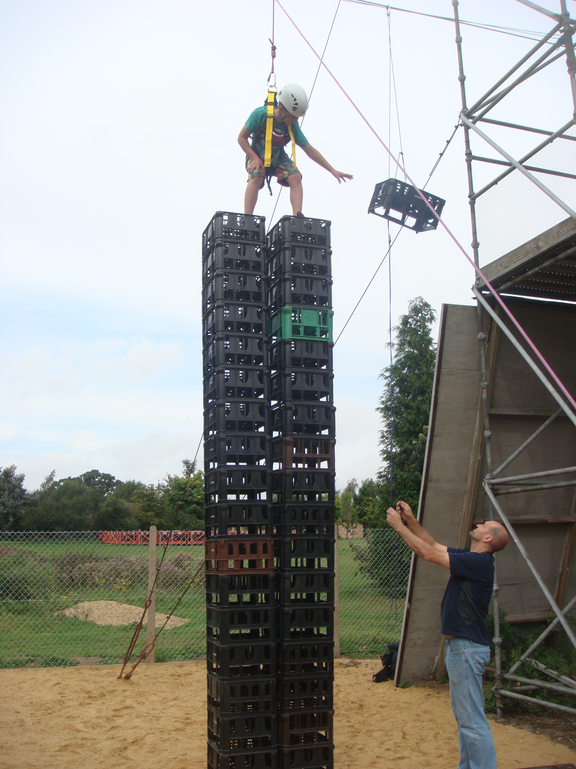
Crate Stacking Part 3
You have 1 minute to…
Find building blocks – Jenga blocks, Dice or DVDs you decide – Go!
Build the tallest tower – Go!
To find a tape measure and measure your tower – Go!
(If your tower falls or you don’t have a tape measure you lose).
Write your answer in centimetres on the back of the Tent Card and hold it up to the camera.

Slide 13
Back for Lunch

Slide 14


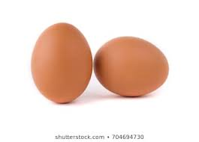
Lunch - Fried Egg Sandwiches
You have 6 eggs, you break two, you fry two and you eat two. How many eggs do you have left?
Everyone online has to agree the answer, before we can move on…
Notes:
Answer is 4. You are actually cooking using two eggs for lunch hence you break, fry and eat the same two eggs. 6-4=2
14

Slide 15
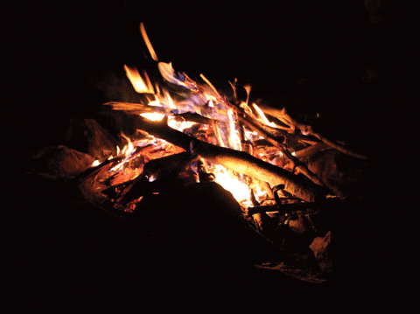
Orienteering
Find the word that is spelt by these 4-figure grid references….
3879
3784
4841
2554
4473
3358
6895
5176
C
A
M
P
F
I
R
E
Notes:
CAMPFIRE – letter revealed from the top
15

Slide 16
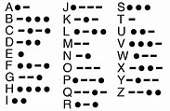
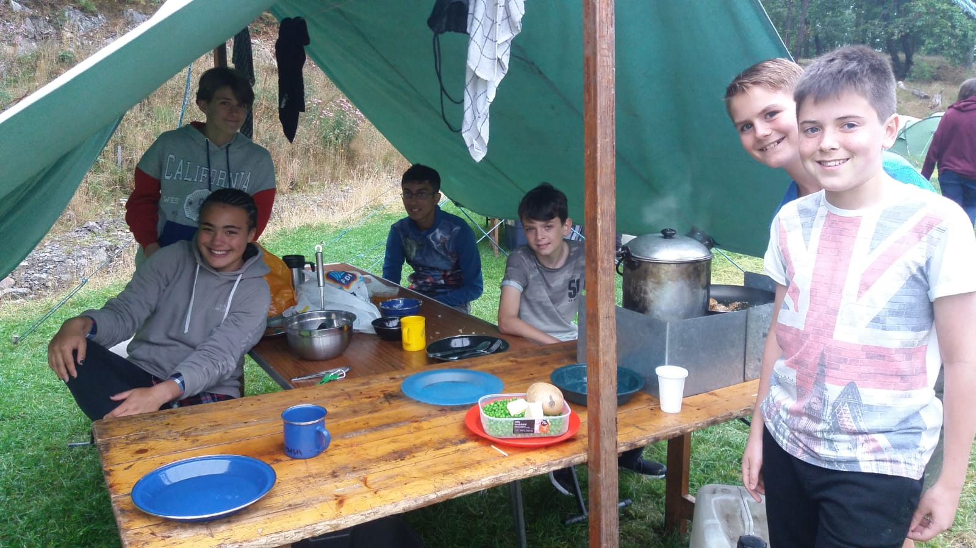
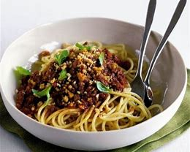
You need work out what this message says to get your dinner
... .--. .- --. .... . - - ..
-... --- .-.. --- --. -. . ... .
Notes:
Move mouse over play button to hear Morse code. Next Mouse hit will reveal dish.
Spaghetti Bolognese
16

Slide 17
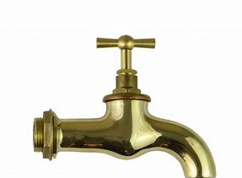
Washing up after dinner
The wacky pluming
Which bowl fills up first?
Which bowls stay empty?
Which bowls only partially fill up?
1
2
3
4
5
6
Notes:
4 Will fill up first and overflow. 5 and 6 will never fill up and 1,2 and 3 will only partially fill up. You can decide how many of these answers you actually wan to extract.

Slide 18
Time for a campfire

Slide 19
How many campfire songs do you know?
Write them on the Tent Card – you have 1 minute.

Slide 20
Time to do flag down and go home

Slide 21
Flag down
First person to do a scarf flip – Go!
First person to stuff their sleeping bag back into their sleeping bag holder – Go!
Points on the back of the tent card
Flag down
Closing prayer
Dear God
thanks for keeping us safe during this difficult time
and allowing us to still have fun online
Amen.

Slide 22
Thanks for coming to visit
Hope to see you when we are open properly…

